Slide 1
Pinewood Derby
Speed Clinic
“The Reverse Build”
By
Ed Teran, RJ Teran & Vincent Teran

Slide 2
Decide on car design
Let your son decide if he wants to design a car for “speed” or one for “looks”
Either way, you can still use these speed techniques
Build two cars. You build one and let your son build the other (same design)

Slide 3
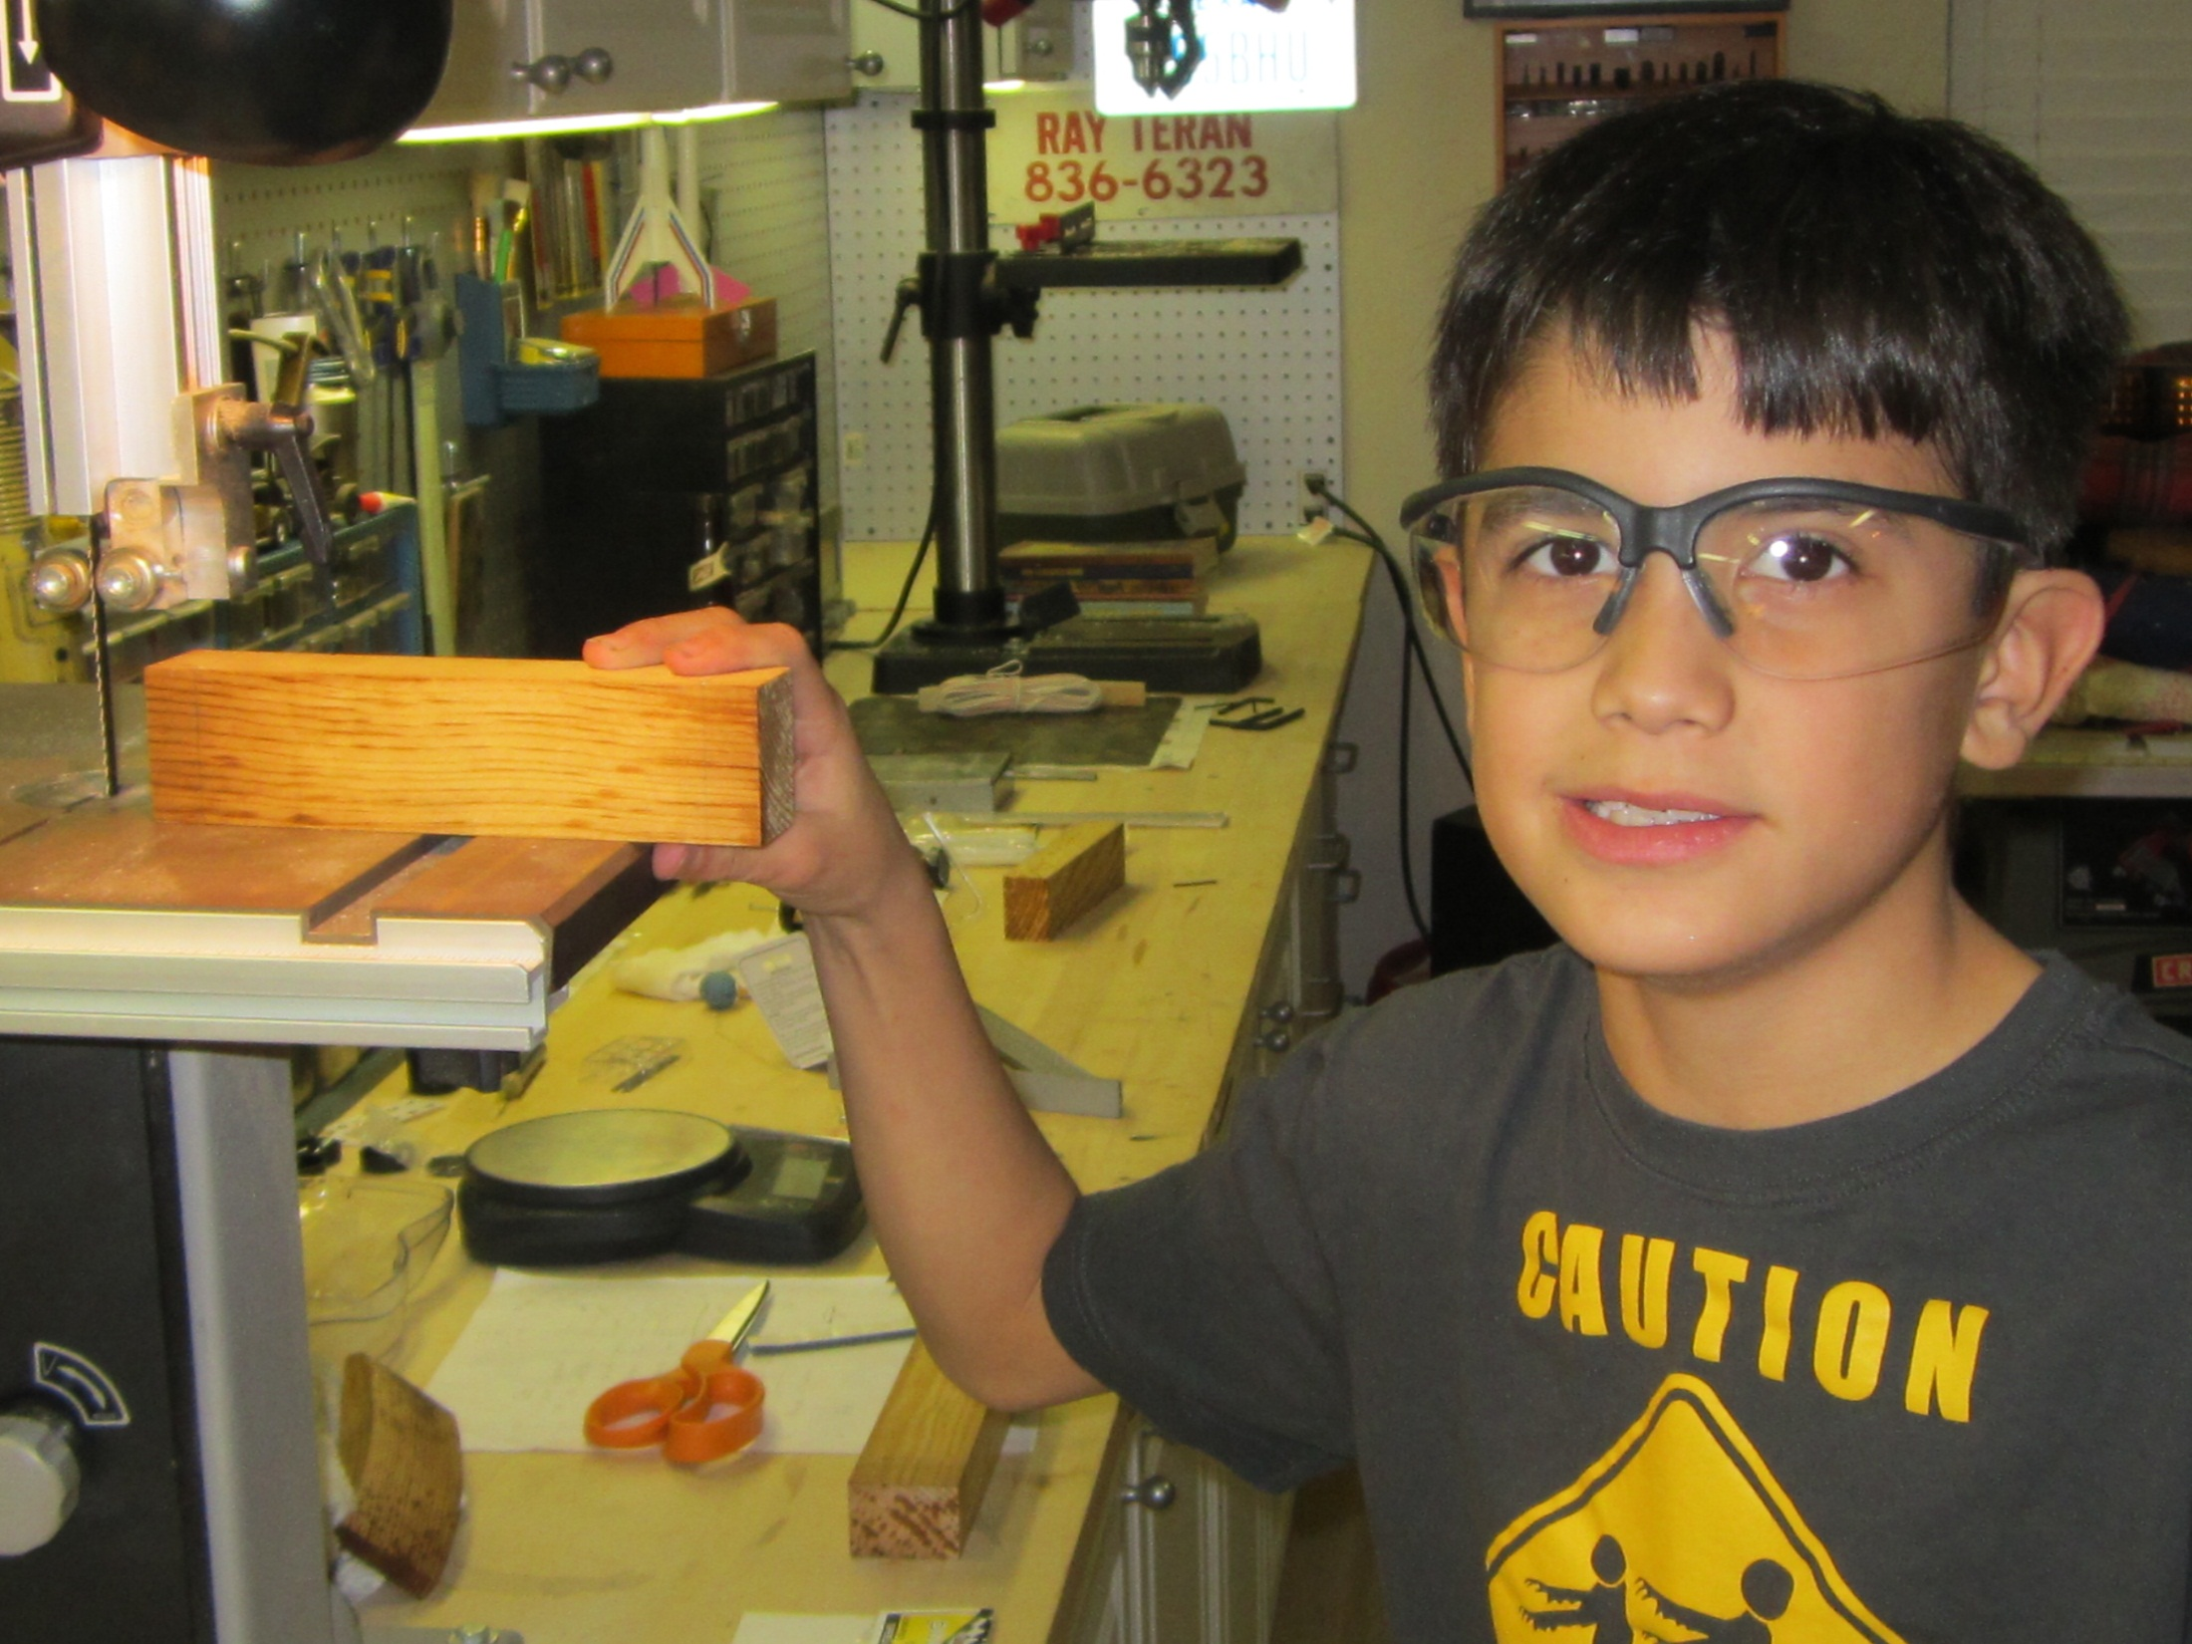

Slide 4
Principles of Speed
Maximize Potential Energy
  PE= mass x gravitational pull x height
  Place as much weight as possible to rear of car
Reduce Friction
  Less friction = more speed
Reduce wheel inertia

Slide 5
Reverse Build Concept
weight of tungsten weight
weight of wheels and axles
weight of any decorations
+ weight of paint
--------------------------------------------
= sub-total weight
Weight of car body = 5.00 oz. – sub-total weight

Slide 6
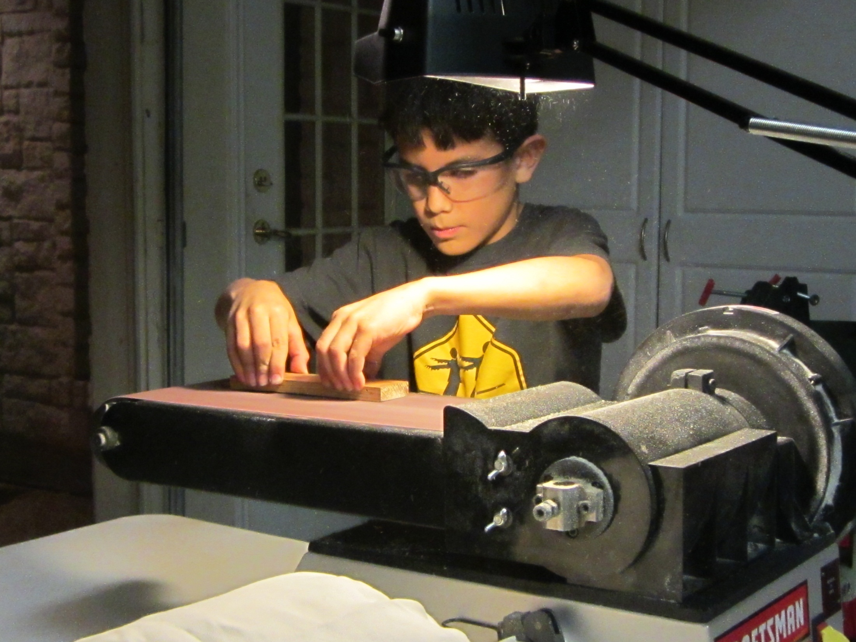

Slide 7
Reverse Build Steps
Bake the car (remove water .25 to .53oz)
Extend the wheel base
Determine weight needed
Prepare wheels and axles
Determine weight placement
Test wheel alignment

Slide 8
Step 1 – Bake the car
The more weight you move to the rear of the car, the faster your car will go
Preheat oven to 250 degrees
Bake the block for 1-2 hours.

Slide 9
Step 2 – Extend the wheelbase
Front wheel closer to front and rear wheels closer to rear of car.
Mark the block, 5/8 inch from front and from rear of car and 1/8” up from bottom of car (use Pro Body tool)
Drill new axle holes
Raise one wheel (use Pro Body tool)

Slide 10
Step 3 – Determine weight
Determine weight needed for car body and weight to be added to car.
weight of tungsten weight
weight of wheels and axles
weight of any decorations
+ weight of paint (.15 to .26 oz)
--------------------------------------------
= sub-total weight
Weight of car body = 5.00 oz. – sub-total weight

Slide 11
Step 4 – Prepare Wheels and Axles
Remove burrs and scratches
Use drill and triangle file to reshape axle head then use various grit (320 grit to 1500 grit) wet/dry sandpaper to polish nail surface.
Wheels- use pipe cleaner to polish inside of wheel hub with graphite lubricant

Slide 12
Step 5 – Weight Placement
Place weight so that the center of gravity is ¾ inch to 1 inch in front of rear axle.
This means the car should be balanced approx. ¾ to 1 inch in front of rear axle.
¾ to 1 inch
Front Rear

Slide 13
General Tips
Place painters tape on the car where the wheels will contact the card body before painting.
Rub graphite lubricant on all contact points

Slide 14
Tools and Links
Maximum Velocity.com website
  Pro-Body Tool, Pro-Axle Press
  http://www.maximum-velocity.com/?gclid=COCfg8nW6LsCFSdp7Aod4h4A1w
You can purchase many of the tools and tungsten barrel weights at Hobby Lobby.
Scout shop carries these tools as well along with the book on speed tips.

